Slide 1
INTRODUCTION TO .NET FRAMESWORK

Slide 2
What is .NET?
.NET is a framework to develop software applications. It is designed and developed by Microsoft and the first beta version released in 2000.
It is used to develop applications for web, Windows, phone. Moreover, it provides a broad range of functionalities and support.
.NET is a new framework for developing web-based and windows-based applications within the Microsoft environment.
The framework offers a fundamental shift in Microsoft strategy it moves application development from client-centric to server-centric.
It is a Operating System Hardware.

Slide 3
What Languages Does .NET Core Support?
NET Core is not limited to a single programming language and supports C#, VB.NET, F#, XAML, and TypeScript. These programming languages are open source and managed by independent communities. . NET Core offers the most advanced, mature, and extensive class libraries, common APIs, multi-language support, and tools.
C# (pronounced “see-sharp”) is the actual coding language that we write inside of the . NET framework. C# is an object-oriented programming language, meaning it can increase productivity in the development process

Slide 4
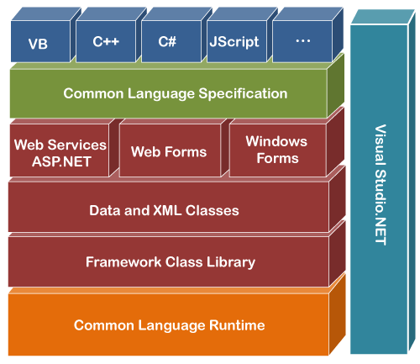
.NET FRAMEWORK SERVICES
Common Language Runtime
Windows Forms
ASP.NET
Web Forms
Web Services
ADO.NET, evolution of ADO
Visual Studio.NET

Slide 5
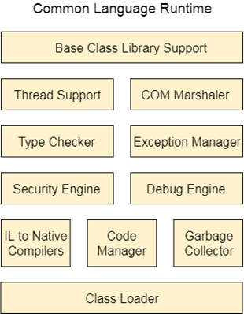
Common Language Runtime
CLR works like a virtual machine in executing all languages.
All .NET languages must obey the rules and standards imposed by CLR. Examples object declaration, creation and use data types, language libraries error and exception handling interactive development environment (IDE)

Slide 6
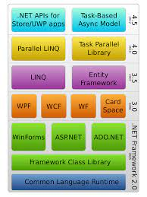
Window Frames
Windows Forms is a smart client technology for the .NET Framework, a set of managed libraries that simplify common application tasks such as reading and writing to the file system.
Framework for Building Rich Clients
RAD (Rapid Application Development)
Rich set of controls
Data aware
ActiveX Support
Licensing
Accessibility
Printing support
Unicode support
UI inheritance

Slide 7
ASP.NET
ASP.NET the platform services that allow to program Web Applications and Web Services in any .NET language.
ASP.NET Program is compiled into a .NET class and cached the first time it is called. All subsequent calls use the cached version.
ASP.NET Uses .NET languages to generate HTML pages. HTML page is targeted to the capabilities of the requesting Browser.
ASP.NET is a web framework designed and developed by Microsoft. It is used to develop websites, web applications, and web services. It provides a fantastic integration of HTML, CSS, and JavaScript. It was first released in January 2002.

Slide 8
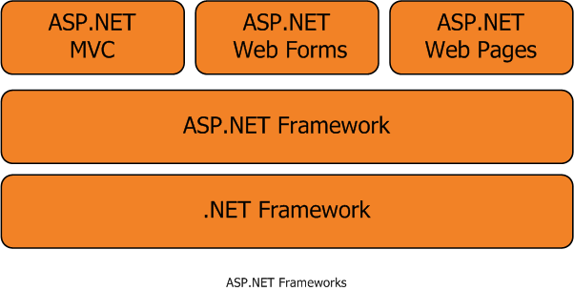
ASP.NET WEB FORMS
Allows clean cut code
Code-behind Web Forms
Easier for tools to generate
Code within is compiled then executed
Improved handling of state information
Support for ASP.NET server controls
Data validation
Data bound grids

Slide 9
ASP.NET WEB SERVICES
It is just an application that exposes its features and capabilities over the network using XML to allow for the creation of powerful new applications that are more than the sum of their parts
A programmable application component accessible via standard Web protocols.
ADO.NET
ADO.NET is a module of .Net Framework, which is used to establish a connection between application and data sources. Data sources can be such as SQL Server and XML. ADO .NET consists of classes that can be used to connect, retrieve, insert, and delete data.

Slide 10
DIFFERENT VERSIONS OF .NET FRAMEWORKS
.NET Frameworks 1.0
This is the first release of the .NET framework , released on 13 feb 2002.
It was available for Windows 98, NT 4.0,and XP.
Mainstream support ended 14 July 2009, with the exception of XP media center and table PC editions.
.NET Frameworks 1.1
This was published on 3 April 2003.
This is also the part of the second release of Microsoft Visual Studio .NET.
This is the first version of the .NET Frameworks to be included as part of Windows operating system.

Slide 11
.NET Frameworks 2.0
It is released with VS 2005, MSSQL 2005, and BizTalk 2006.
It is included as part of visual studio 2005 and Microsoft SQL Server 2005.
Version 2.0 without any service pack is the last version with support for Window 98 and Windows Me.
.NET Frameworks 3.0
.NET Framework 3.0 formerly called WinFX, was released on 21 November 2006.It included a new set of managed code.
There are no major architectural changes included with this release.
.NET Frameworks 3.5
Version 3.5 of the .NET Framework was released on 19th November 2007.
As with .NET framework 3.0, version 3.5 uses the CLR of version 2.0

Slide 12
.NET Frameworks 4.0
Introduction parallel extensions , Which targets multicore system.
Support for Code contracts.
Inclusion of new types to work with arbitrary precision arithmetic and complex number.
.NET Frameworks 4.5
.NET Framework 4.5 was released on 15 August 2012.
Portable Class Libraries
Parallel Computing
Core New features and improvements

Slide 13

THANK YOU

